Slide 1
Real-Time Human Head Detection and Replacement Using Raspberry Pi
TEAM ROCKET:
Varsha
Deepanshu
Pranav
Hanish

Slide 2
Contents
Project Goal
Hardware
Software Description
Verification of Hardware Setup
Flow Diagram
Methods
Results

Slide 3
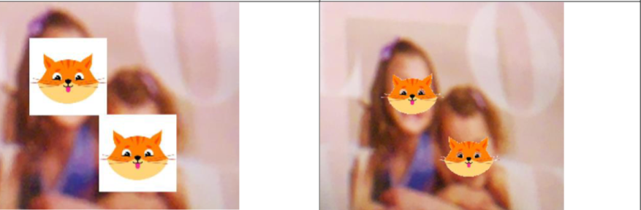
Project Goal
Detect human heads and replace it with Cat heads

Slide 4
Hardware
Raspberry Pi 5
SunFounder Camera Rev 1.3
HBV - Raspberry - 300FPC

Slide 5
Software Description
Category | Tools / Libraries | Purpose / Use
Programming Environment | Python 3.x, Raspberry Pi OS, Thonny / VS Code | Writing and running the code
Camera Interface | Picamera2 | Capture images from Raspberry Pi Camera Module
Computer Vision & Image Processing | OpenCV (cv2), NumPy | Face detection, image conversion, overlay PNGs, alpha blending, display frames
Face Detection Model | Haar Cascade (haarcascade_frontalface_alt2.xml) | Pre-trained classifier for detecting human faces
Graphic Resources | PNG image with transparency (cats.png) | Overlay images on detected faces
User Interaction | OpenCV waitKey() | Keyboard controls: 'q' to quit, arrow keys to switch overlays
Mathematical Operations | NumPy array operations | Alpha blending, array slicing, image resizing
Hardware | Raspberry Pi 4/5, Camera Module v3 | Physical hardware used
Installation | install opencv-python numpy picamera2 | Installing required Python libraries

Slide 6
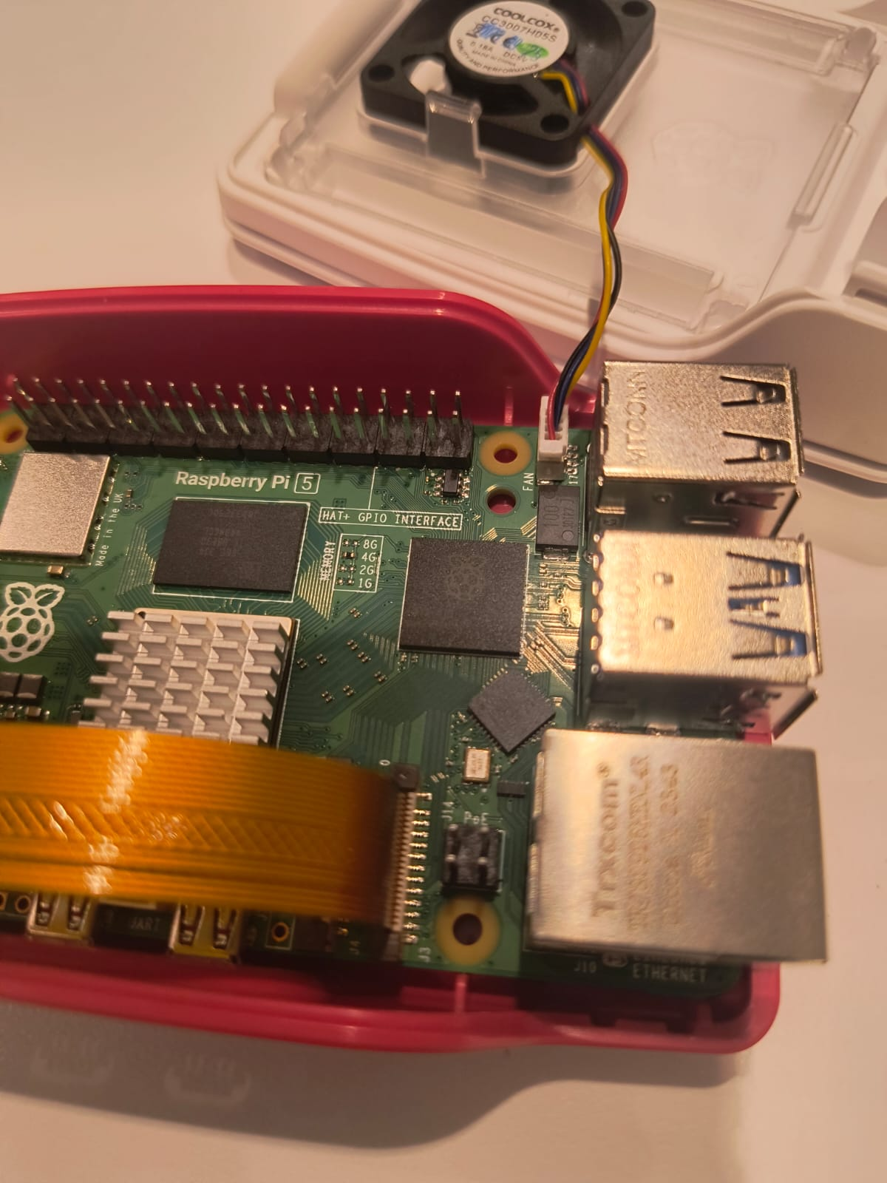
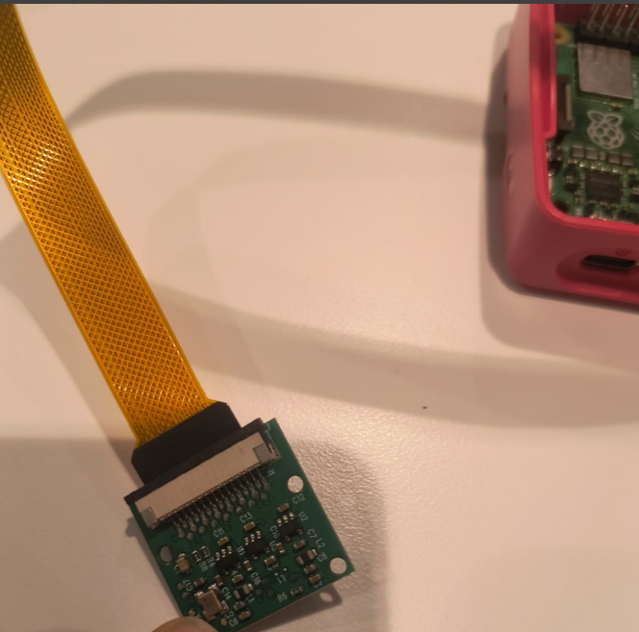
Verifying Camera setup and wiring
Before coding, the camera wiring and connection were verified using:
sudo apt update
sudo apt install rpicam-apps
rpicam-hello

Slide 7
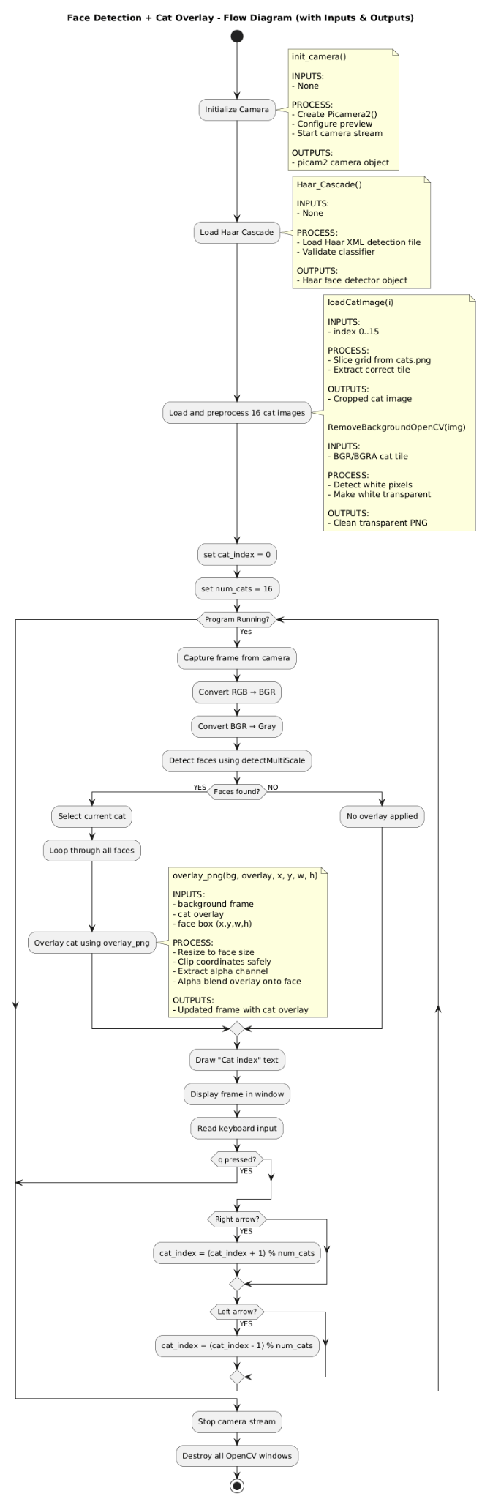
Flow Diagram

Slide 8
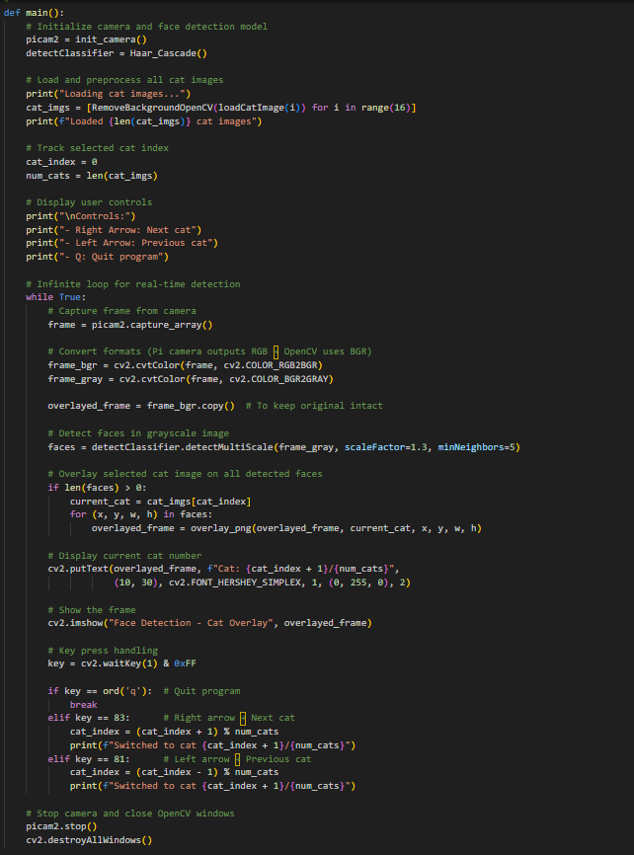
METHODS
Notes:
Scale - how much object scaled at each stage, minNeighbours*/m
][;p

Slide 9
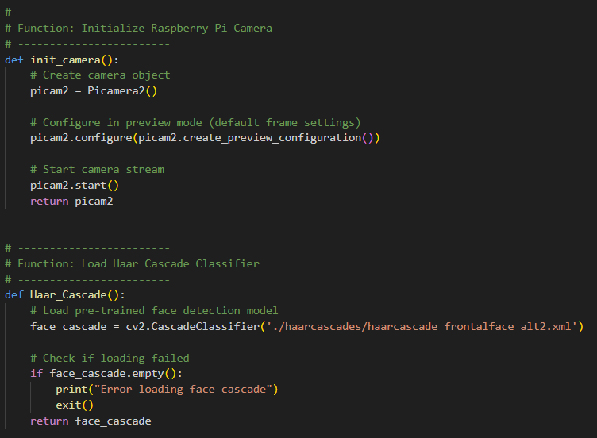
METHODS
Notes:
Array.shape - (480,640,4). RGB888. Concept: Haar feature-based cascade is a multi-stage system where each stage rejects non-face regions quickly, making detection efficient. Suitable for rpi

Slide 10
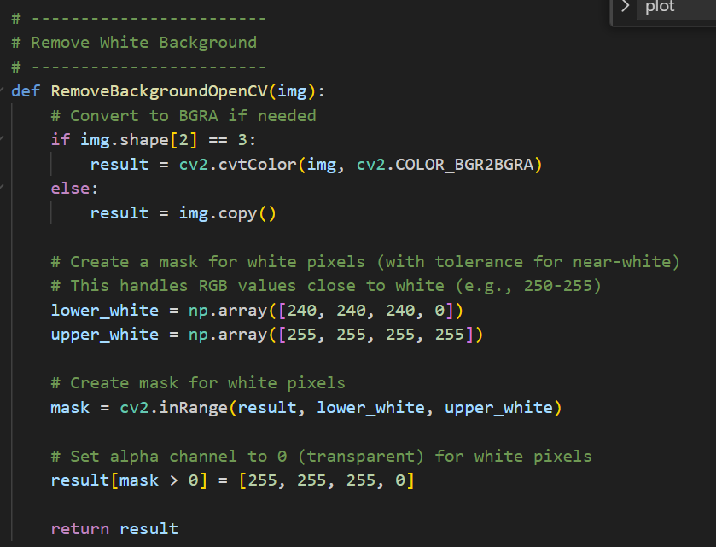
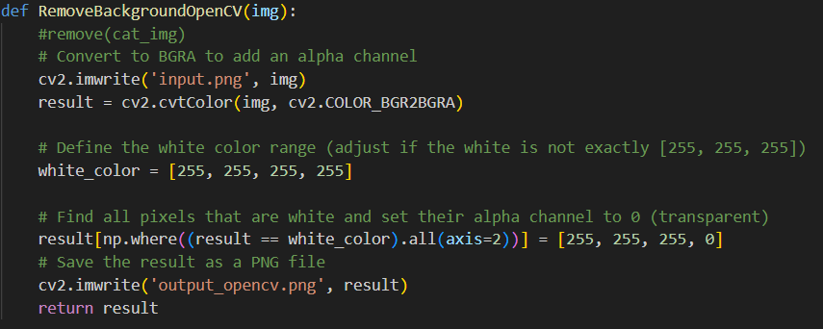

METHODS
RemoveBackgroundOpenCV
Method 2
Method 1

Slide 11
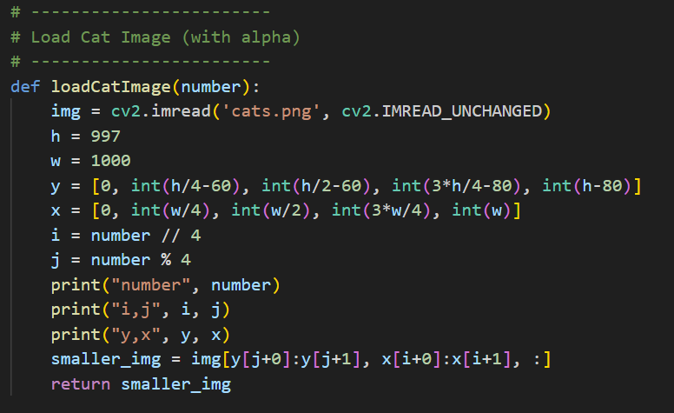
METHODS
loadCatImage
Notes:
16 cat images, pre defined offsets, we return each cat

Slide 12
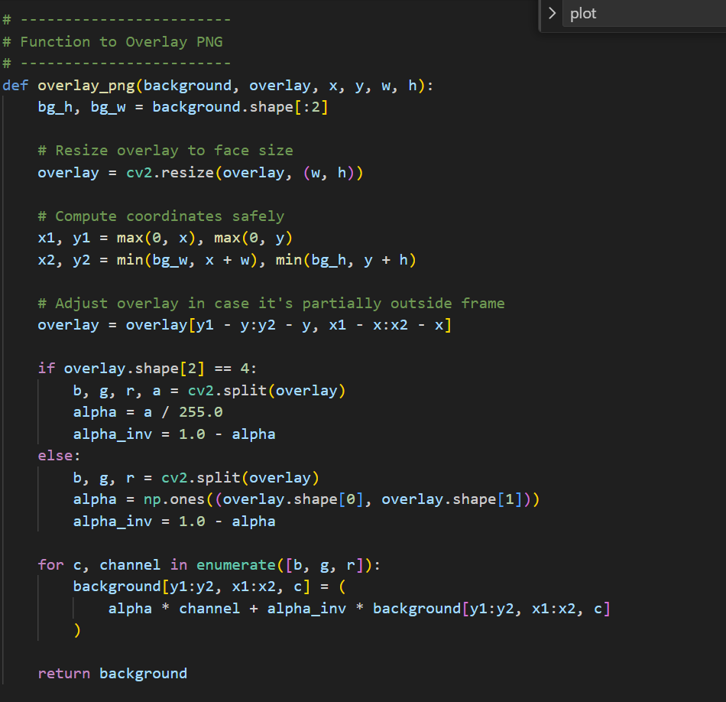
METHODS
overlay_png
Notes:
Resize the cat image; Alpha blending. output_pixel = α × overlay_pixel + (1 - α) × background_pixel

Slide 13
Challenge | Solution (How we solved it in code)
Detection affected by lighting | - Converted frames to grayscale for consistent detection. - Tuned Haar cascade parameters: scaleFactor=1.3, minNeighbors=5. - Used Picamera2 auto-exposure to stabilize brightness.
Handling multiple faces at once | - Loop through all detected faces and overlay cat images individually. - Resized each cat image to face bounding box (x, y, w, h). - Applied coordinate clipping to prevent overlays outside the frame.
Removing background was not smooth | - Converted cat images to BGRA (added alpha channel). - Applied white pixel thresholding (RemoveBackgroundOpenCV) to remove white/near-white pixels. - Set alpha = 0 for transparent background → smooth overlay.
Camera won’t detect side images | - Haar cascade (frontalface_alt2.xml) detects only frontal faces. - Side/angled faces don’t match trained features → detection fails. - Future solution: use DNN-based face detectors or profile cascades (haarcascade_profileface.xml).

Slide 14
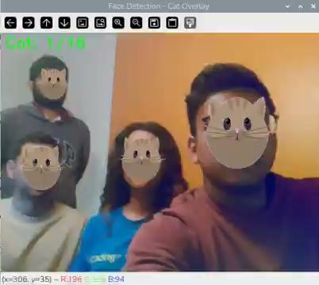
Results

Slide 15

Thank You
QnA?

